Slide 1

Deep Learning Based Corn Leaf Disease Classification Using CNN Architecture
B.Sc. Final-Defense

Slide 2
Outline
Introduction
Objective
Background Study
Gap Analysis
Methodology
Results & Analysis
Novelty of the Work
Sample Dataset & Expected Output
Web Interface
Conclusion
References
B.Sc. Final-Defense

Slide 3
Introduction
Corn is an important crop used for food, animal feed, and many industries.
Its production often decreases because of leaf diseases like Common Rust, Corn Leaf Blight, Gray Leaf Spot, and Maize Chlorotic Mottle Virus.
Farmers usually check leaves by hand, but this method is slow, tiring, and not always accurate, especially in real field conditions.
Modern Deep Learning and Computer Vision can now detect diseases automatically from leaf images with high accuracy.
In this project, a deep-learning system was built using real corn leaf photos collected from Shahjahanpur, Bogura.
Several advanced CNN models and ensemble methods were tested to find the best and most reliable model for practical use in agriculture.
B.Sc. Final-Defense

Slide 4
Objective
To classify five major corn leaf conditions Common Rust, Corn Leaf Blight, Gray Leaf Spot, Maize Chlorotic Mottle Virus, and Healthy Leaf using deep learning techniques.
To develop and fine-tune state-of-the-art CNN architectures for accurate and reliable corn leaf disease detection under real-field conditions.
To build three ensemble models and one hybrid CNN model that use multiple networks together to improve accuracy and reliability in corn leaf disease detection.
To perform a comparative evaluation of multiple deep learning models and identify the most robust architecture based on accuracy, precision, recall, F1-score, MCC, and cross-validation.
To design a deployable deep learning model that can be integrated into mobile or web-based systems for real-time corn leaf disease diagnosis.
B.Sc. Final-Defense

Slide 5
Background Study
Authors (Year) | Model Used | Dataset | Key Contribution / Finding
Fraiwan et al. (2022) | Pre-trained CNNs (Transfer Learning) | Corn leaf images | Achieved 98.6% accuracy without heavy preprocessing; showed TL is highly effective.
Li et al. (2023) | MDCDenseNet (Multi-dilated + CBAM) | Small, noisy, complex-background maize images | Improved robustness; strong performance in real-field-like noisy data.
Wang et al. (2022) | Improved GoogleNet + ArcFace + A-Softmax | 30,000+ NCLB images (augmented) | Highest reported accuracy (99.94%); excellent NCLB detection.
Divyanth et al. (2023) | UNet → DeepLabV3+ (Two-stage segmentation) | Real field corn images | High lesion segmentation accuracy (mIoU = 0.9422); supports severity estimation.
Khan et al. (2023) | YOLOv3-tiny → YOLOv8n | Mobile-captured maize leaf images | Real-time detection on mobile; 99.04% accuracy on device.
Gopalan et al. (2025) | ResNet152 + Grad-CAM | Corn leaf dataset | High accuracy + explainability; visualizes disease regions effectively.
Bachhal et al. (2024) | PSPNet + ResNet50 + Fuzzy-SVM | Hybrid dataset | Robust hybrid pipeline; 96.7% mAP for maize leaf disease recognition.
B.Sc. Final-Defense

Slide 6
Gap Analysis
Most studies used lab-quality or PlantVillage datasets, not real-field images.
Very limited research used Bangladesh-specific maize disease datasets.
Many works focused on single or 2–3 disease classes, not full multiclass classification.
Most studies used single CNN models, with very few ensemble or hybrid approaches.
Many papers did not use cross-validation, reporting only a single accuracy value.
B.Sc. Final-Defense

Slide 7
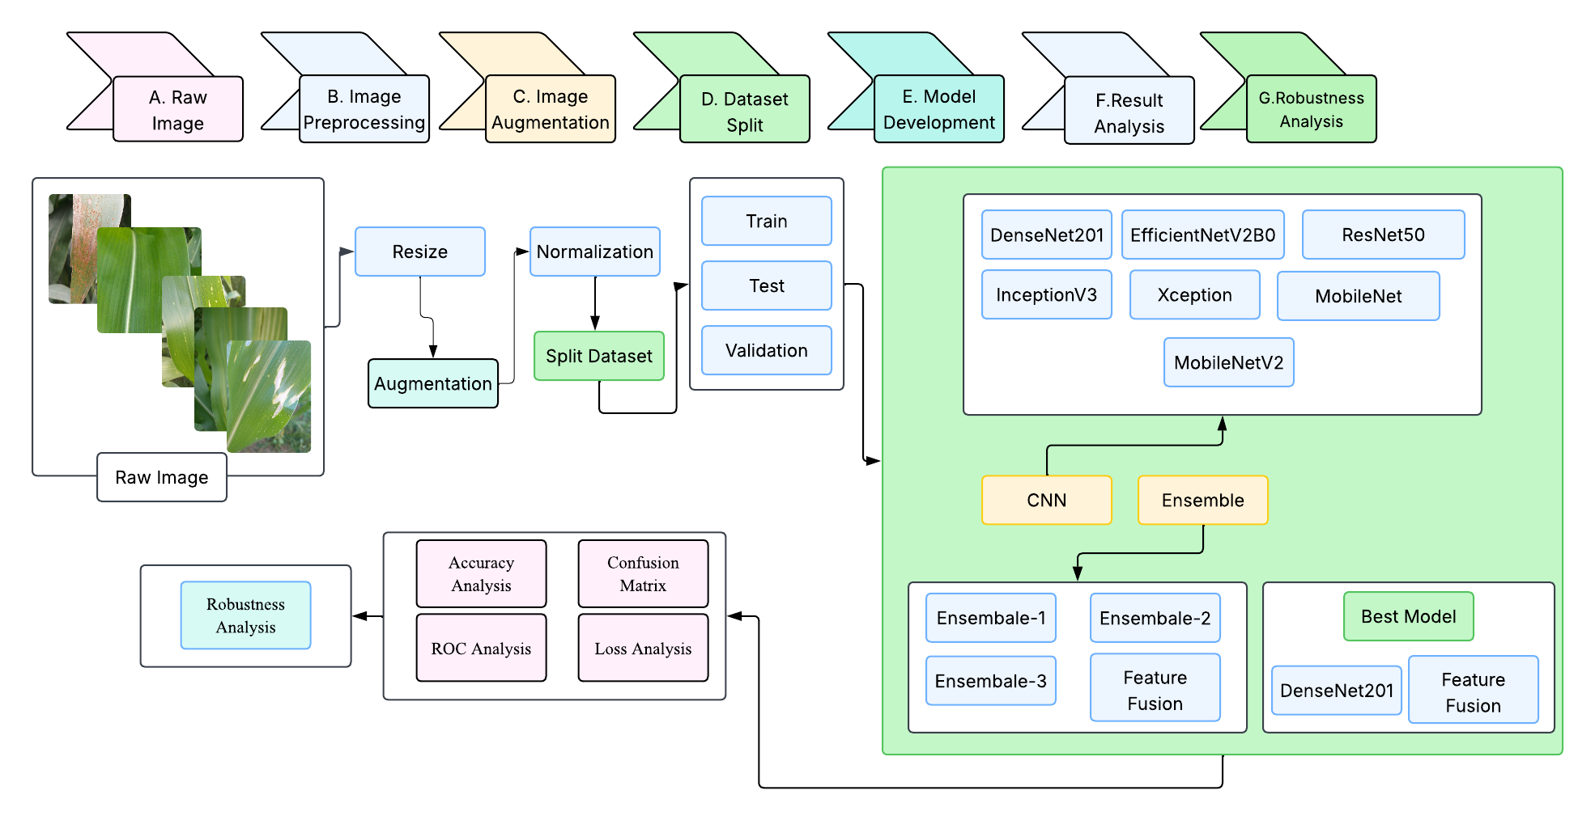
Methodology
B.Sc. Final-Defense

Slide 8
Result and Analysis
Performance Summary of Fine Tune CNN Models
Model | Accuracy (%) | Precision (%) | Recall (%) | F1-score (%) | MCC (%)
DenseNet201 | 99.65 | 99.65 | 99.65 | 99.65 | 99.56
EfficientNetV2B0 | 99.23 | 99.20 | 99.20 | 99.20 | 99.03
InceptionV3 | 99.30 | 99.30 | 99.30 | 99.30 | 99.12
ResNet50 | 98.94 | 98.90 | 98.90 | 98.90 | 98.60
Xception | 98.52 | 98.50 | 98.50 | 98.50 | 98.20
MobileNet | 98.80 | 98.70 | 98.70 | 98.70 | 98.50
MobileNetV2 | 98.10 | 98.10 | 98.10 | 98.10 | 97.70
B.Sc. Final-Defense

Slide 9
Result and Analysis
Performance Summary of Ensemble Model
Ensemble Configuration | Accuracy (%) | Precision (%) | Recall (%) | F1-Score (%) | MCC(%)
DenseNet201 + EfficientNetV2B0 | 98.55 | 98.6 | 98.6 | 98.6 | 98.3
DenseNet201 + EfficientNetV2B0 + InceptionV3 | 99.30 | 99.3 | 99.3 | 99.3 | 99.1
Xception + MobileNet + MobileNetV2 + ResNet50 | 99.01 | 99.02 | 99.01 | 99.01 | 98.77
B.Sc. Final-Defense

Slide 10
Result and Analysis
Performance Summary of Feature Fusion Model
Model | Classes | Precision | Recall | F1-Score | Support
Hybrid Feature Fusion | Common_Rust | 1.0000 | 1.0000 | 1.0000 | 283
 | Corn Leaf Blight | 0.9965 | 1.0000 | 0.9982 | 285
 | Gray Leaf Spot | 1.0000 | 0.9929 | 0.9965 | 283
 | Healthy | 1.0000 | 1.0000 | 1.0000 | 287
 | Maize Chlorotic Mottle Virus | 0.9965 | 1.0000 | 0.9982 | 282
 | Accuracy |  |  | 0.9986 | 1420
 | Macro Avg | 0.9986 | 0.9986 | 0.9986 | 1420
 | Weighted Avg | 0.9986 | 0.9986 | 0.9986 | 1420
Cross Validation Result
Model | Fold-1 | Fold-2 | Fold-3 | Fold-4 | Fold-5 | Main Model
Accuracy | 99.20% | 99.56% | 99.28% | 99.73% | 99.65% | 99.86%
B.Sc. Final-Defense

Slide 11
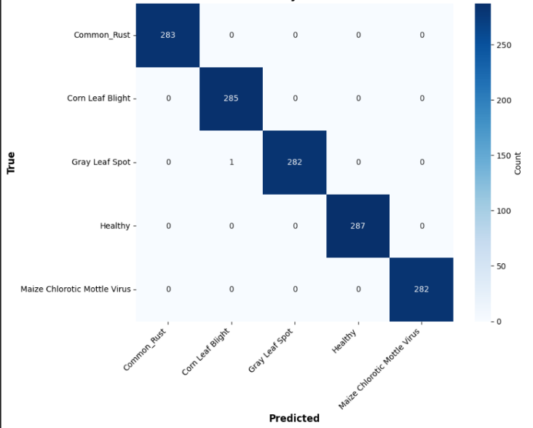
Result and Analysis
Confusion Matrix of Feature Fusion Model
Confusion matrix shows near-perfect diagonal dominance.
Out of 1420 samples, the model misclassified only 2 images (Gray Leaf Spot).
All other four classes are predicted with 100% precision & recall.
Indicates exceptional robustness even on real-field images.
B.Sc. Final-Defense

Slide 12
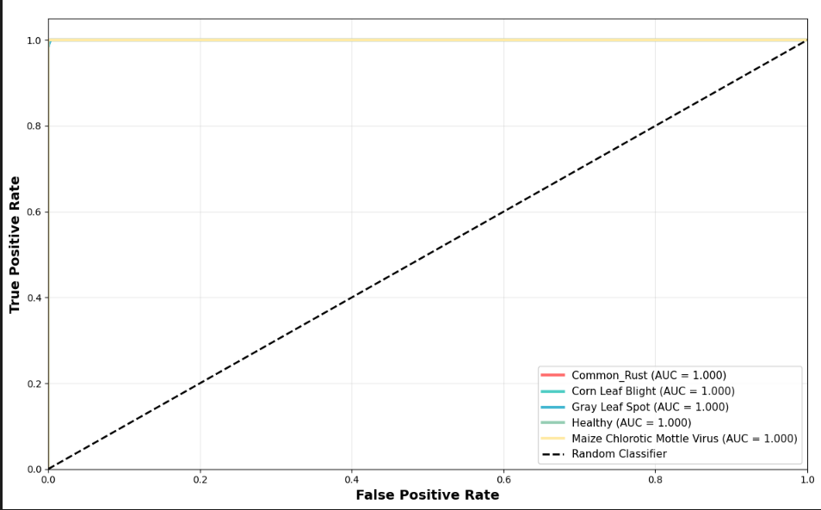
Result and Analysis
Roc Curve of Feature Fusion Model
All five classes achieved a perfect AUC score of 1.000.
Curves lie far above the random classifier baseline, showing excellent discriminative ability.
The model confidently separates correct and incorrect classes based on probability.
Indicates near-perfect ranking performance and highly reliable class prediction.
B.Sc. Final-Defense

Slide 13
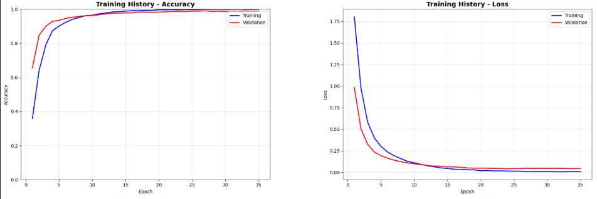
Result and Analysis
Training and Validation Accuracy & Loss of Feature Fusion Model
Training and validation accuracy increase smoothly and converge near 100%.
Loss decreases consistently without fluctuation, showing stable optimization.
No gap between train and validation curves → no overfitting.
The model generalizes extremely well across field images and unseen data.
B.Sc. Final-Defense

Slide 14
Novelty of the Work
Bangladesh-Specific Dataset Creation
Comprehensive corn leaf disease dataset from Bangladesh agricultural fields Reflects local disease patterns and environmental conditions
2. Systematic Architecture Comparison
Evaluated 7 CNN models + 3 ensembles on same dataset with cross validation and Provides benchmark for future research in Bangladesh
3. Hybrid Feature Fusion Approach
Novel combination of InceptionV3 + DenseNet201 for corn disease Achieves 99.86% accuracy with robust cross-validation
B.Sc. Final-Defense

Slide 15
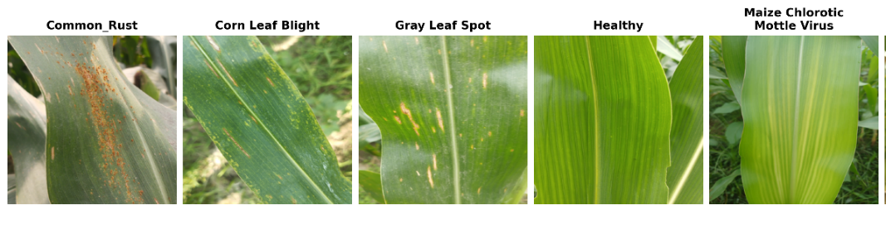
Sample dataset
The “Corn Leaf Disease Detection” dataset used in this study was created expressly for this research. Images were captured in the field with a Redmi Note 12 (50 MP) smartphone during three collection sessions in March 2025 at Shahjahanpur, Bogura (Bangladesh). The raw set contains 1831 images, curated and labelled by plant-pathology experts to support image-based agricultural classification tasks. The dataset is organized to facilitate the identification of corn leaf diseases that most frequently threaten maize production. It is divided into six classes: Common Rust (CR), Corn Leaf Blight (CLB), Gray Leaf Spot (GLS), Healthy Leaf (HL), Maize Chlorotic Mottle Virus (MCMV).
B.Sc. Final-Defense

Slide 16
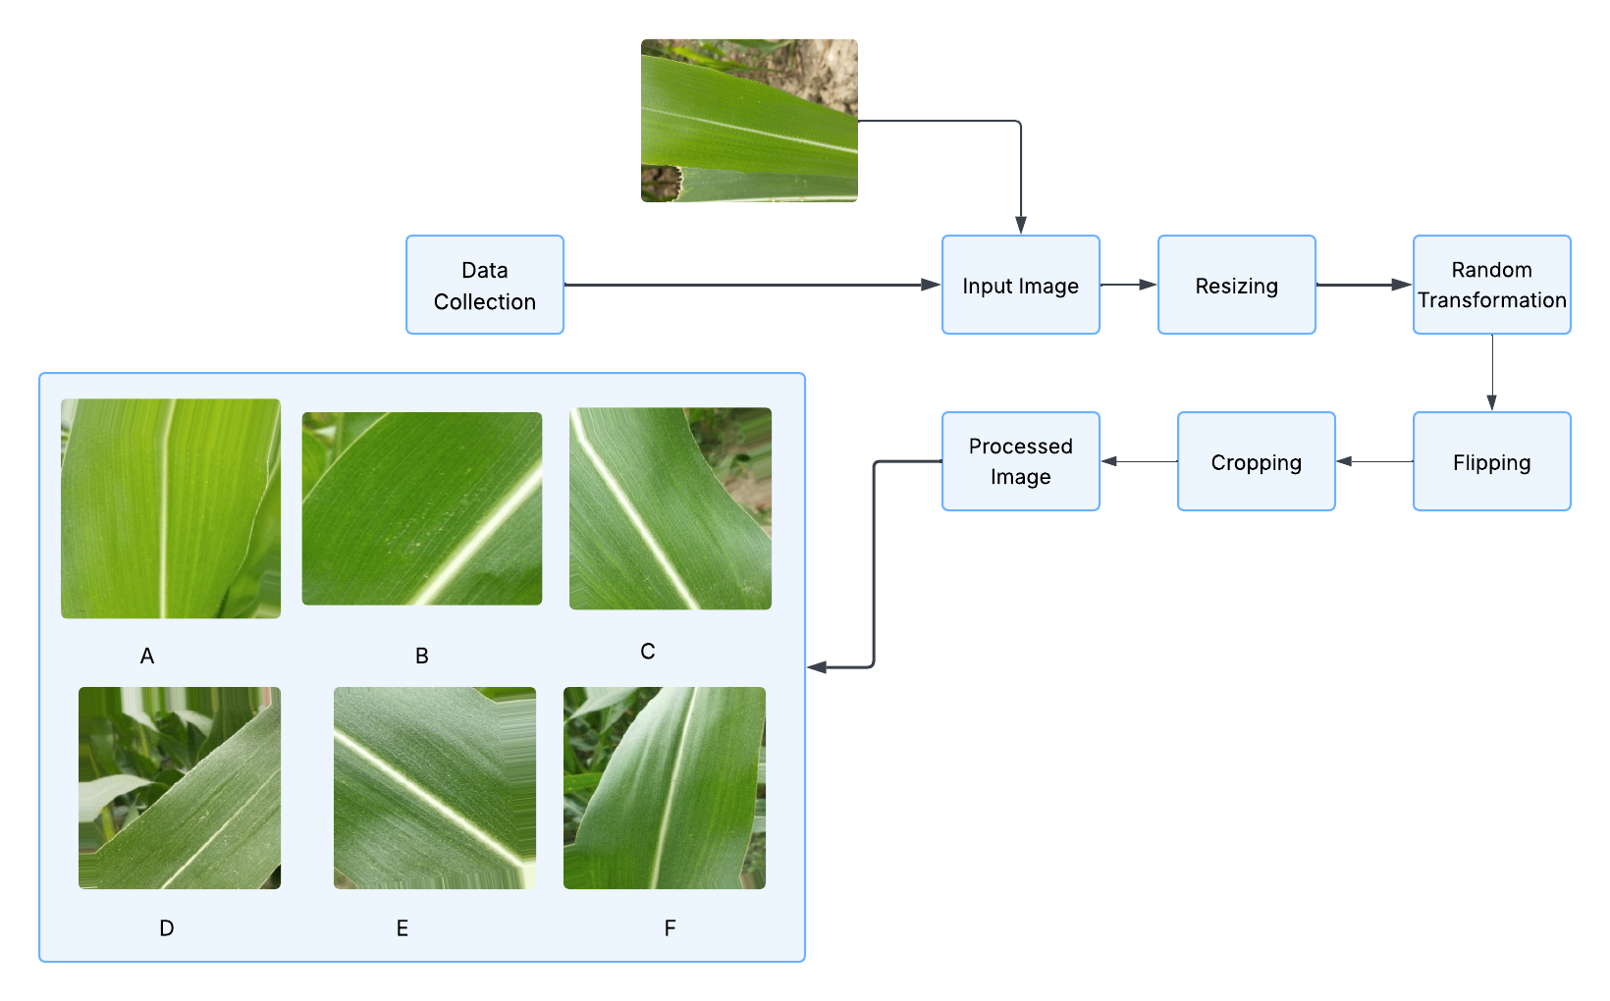
Sample dataset and Expected output
B.Sc. Final-Defense

Slide 17
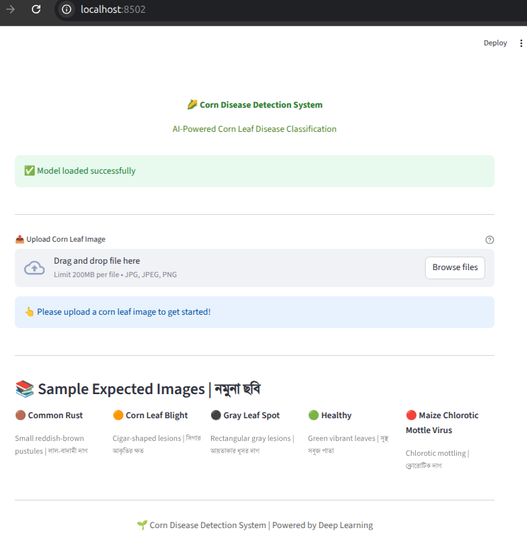
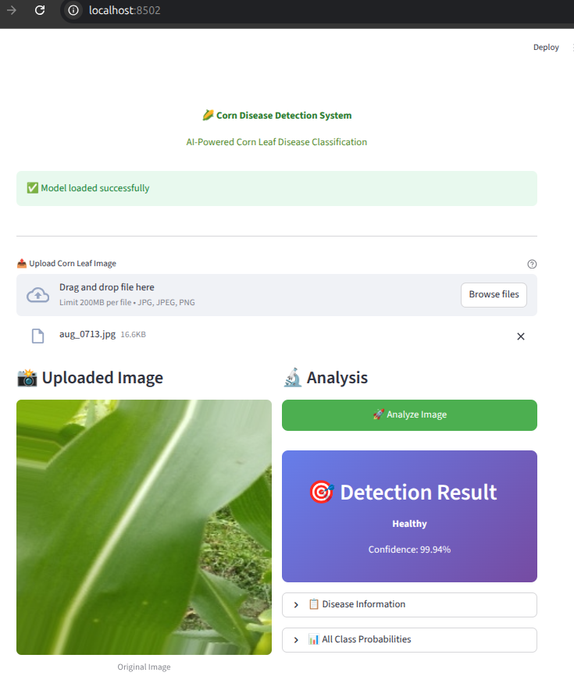
Web Interface of Image Enhancement
B.Sc. Final-Defense

Slide 18
Conclusion
The goal of this research was to develop a reliable deep learning–based system capable of identifying major corn leaf diseases from images.
A total of 1,803 real-field maize leaf images were collected from Shahjahanpur, Bogura, with support from local agricultural experts and plant pathology specialists.
Extensive data augmentation was applied to expand the dataset to 7,068 images, improving model generalizability under diverse field conditions.
Multiple high-performance CNN architectures were trained and evaluated, including DenseNet201, EfficientNetV2B0, InceptionV3, ResNet50, Xception, MobileNet, and MobileNetV2, using a GPU-enabled Kaggle environment.
DenseNet201 achieved the best validation accuracy of 99.65%, showing strong robustness under real-field backgrounds and varying lighting conditions.
The best-performing models were exported in deployable formats for potential integration into future mobile or web-based disease diagnosis platforms.
B.Sc. Final-Defense

Slide 19
References
M. Fraiwan, E. Faouri, and N. Khasawneh, “Classification of corn diseases from leaf images using deep transfer learning,” Plants, vol. 11, no. 20, p. 2668, 2022.
E. Li, L. Wang, Q. Xie, R. Gao, Z. Su, and Y. Li, “A novel deep learning method for maize disease identification based on small sample-size and complex background datasets,” Ecological Informatics, vol. 75, p. 102011, 2023.
Rui, W. A. N. G., Cheng, W. A. N. G., & Hong-yu, P. A. N. (2022). Intelligent diagnosis of northern corn leaf blight with deep learning model. Journal of integrative agriculture, 21(4), 1094-1105.
Divyanth, L. G., Ahmad, A., & Saraswat, D. (2023). A two-stage deep-learning based segmentation model for crop disease quantification based on corn field imagery. Smart Agricultural Technology, 3, 100108.
Khan, F., Zafar, N., Tahir, M. N., Aqib, M., Waheed, H., & Haroon, Z. (2023). A mobile-based system for maize plant leaf disease detection and classification using deep learning. Frontiers in Plant Science, 14, 1079366.
K. Gopalan, S. Srinivasan, M. Singh, S. K. Mathivanan, and U. Moorthy, “Corn leaf disease diagnosis: enhancing accuracy with resnet152 and grad-cam for explainable AI,” BMC Plant Biology, vol. 25, no. 1, p. 440, 2025.
P. Bachhal, V. Kukreja, S. Ahuja, U. K. Lilhore, S. Simaiya, A. Bijalwan, et al., “Maize leaf disease recognition using PRF-SVM integration: a breakthrough technique,” Scientific Reports, vol. 14, no. 1, p. 10219, 2024.
B.Sc. Final-Defense

Slide 20
THANK YOU
B.Sc. Final-Defense

